Slide 1

Analysis on Lithium-ion battery end-of-life cycle assessment For Electric Vehicles
Driving Sustainability: From Waste to Valuable Resources
Presented by : Elvis, Shreyash and ShreyasCourse: ISE 222 Instructor: Dr. Behin ElahiDate: December 5, 2025

Slide 2

The Looming Challenge: EV Battery End-of-Life
The rapid global adoption of electric vehicles (EVs) is a critical step towards sustainable transportation. However, this growth brings an unprecedented wave of end-of-life lithium-ion batteries that demand responsible management.
These sophisticated power sources rely on critical metals such as cobalt, nickel, manganese, lithium, and copper, whose extraction is both resource-intensive and environmentally impactful. Furthermore, significant fossil energy is consumed throughout their production lifecycle.
Without strategic intervention, the benefits of EV adoption could be offset by the environmental burden of battery disposal and resource depletion.

Slide 3




Unlocking Sustainable Pathways: Questions & Objectives
Deconstruct Complexity
Utilize Minitab's statistical power to interpret a complex EV battery Life Cycle Assessment (LCA) dataset.
Compare End-of-Life Strategies
Systematically compare virgin material production against various recycling (partial, full, hydrometallurgical) and repurposing scenarios.
Assess Indicator Interdependence
Examine the relationships between Metal Depletion (MD), Human Toxicity (HT), Climate Change (CC), and Fossil Depletion (FD).
Develop a Composite Index
Employ clustering and Principal Component Analysis (PCA) to discover impact groups and construct a unified environmental burden index.

Slide 4


Dataset & Scenario Types: ReCiPe 2016 Framework
Our analysis draws from a robust LCA dataset by Dunn et al., framed within the ReCiPe 2016 impact assessment method.
End-of-Life Scenarios:
Virgin Material Replacement: Baseline scenarios (A/B/C family variants)
Four Midpoint Indicators:
Recycled Content: Pathways with 50% and 100% recycled material input
Metal Depletion (MD): expressed in Copper equivalents (Cu-eq)
Hydrometallurgical Recycling: An advanced, chemical recycling process
Human Toxicity (HT): expressed in 1,4-Dichlorobenzene equivalents (1,4-DCB-eq)
Repurposing / Second-Life Use: Batteries used in less demanding applications before final recycling
Climate Change (CC): expressed in CO₂ equivalents (CO₂-eq), including biogenic carbon
Fossil Depletion (FD): expressed in oil equivalents (oil-eq)
Silicon-Anode Scenarios (5, 6, 7): Dedicated future technology variants
While ReCiPe 2016 provides endpoint indicators, our focus is on these foundational midpoint categories for detailed environmental impact assessment.

Slide 5

Analysis Workflow: Minitab + Excel
Initial Data Exploration
Inter-Indicator Relationships
Descriptive statistics and comparative boxplots to visualize impact distributions across scenarios.
Pearson correlation matrix to quantify dependencies between midpoint indicators.
Predictive Modeling
Scenario Grouping
Multiple regression (MD as response) to understand predictive power, noting unusual residuals.
Hierarchical cluster analysis (Ward's method) to identify distinct impact clusters.
Dimensionality Reduction
Outlier Identification
Principal Component Analysis (PCA) on standardized indicators to derive a composite burden index.
Excel-based Z-score and Interquartile Range (IQR) analysis to detect statistically significant high and low impact scenarios.

Slide 6
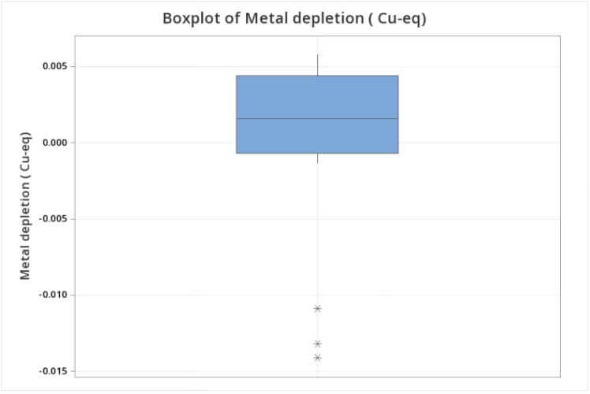
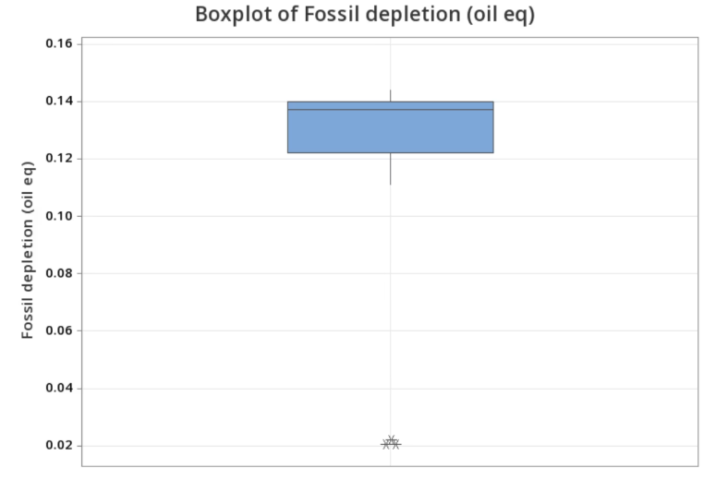
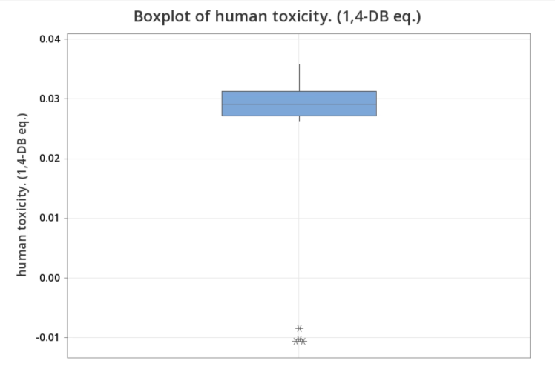
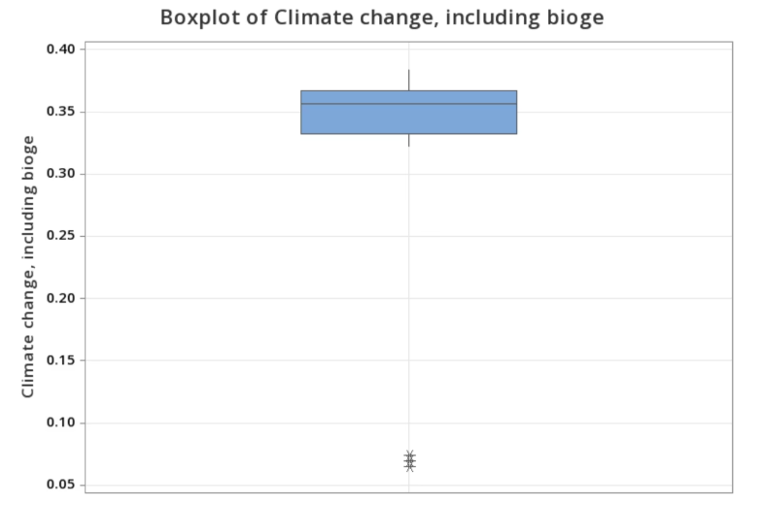
Descriptive Statistics & Boxplots: Impact Patterns
Initial boxplot analysis revealed clear distinctions in environmental impact profiles:
Virgin Material Scenarios: Consistently position at the highest ends for all four midpoint indicators (MD, HT, CC, FD), indicating their substantial environmental footprint.
Recycling's Role: Implementing recycling strategies demonstrably reduces impacts across the board. Notably, some high-recycled content cases even exhibit negative Metal Depletion (MD), signifying a net saving of virgin metal resources rather than depletion.
Repurposing & Hydrometallurgy: Pathways incorporating second-life use and advanced hydrometallurgical recycling move scenarios significantly towards lower impact categories, highlighting their potential for sustainable resource management.

Slide 7
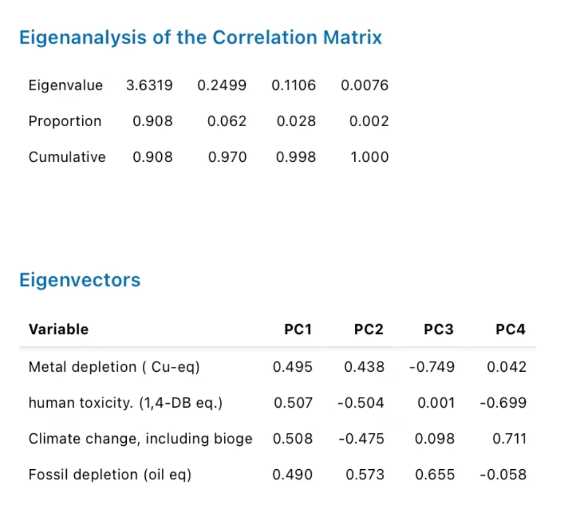
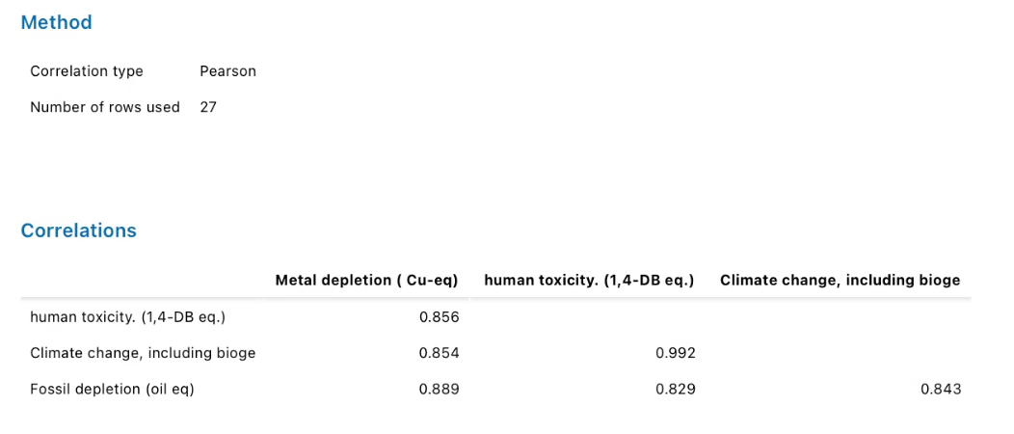
Interdependence of Indicators: Correlation, Regression & PCA
Strong Correlations & Multicollinearity
PCA: A Composite Environmental Burden Index
High Positive Correlations: A Pearson correlation matrix revealed very high positive correlations across nearly all indicator pairs (most r > 0.8). Notably, Human Toxicity (HT) and Climate Change (CC) showed an exceptionally strong correlation of approximately 0.99. This indicates that these indicators largely measure a common underlying environmental burden.
Dominant Principal Component: Principal Component Analysis (PCA) on the standardized indicators showed that PC1 explains approximately 90.8% of the total variance.
Uniform Loadings: All four indicators exhibited similar positive PC1 loadings (ranging from approximately 0.49 to 0.51).
Regression Insights: A multiple regression model predicting Metal Depletion (MD) using HT, CC, and FD as predictors achieved a high R² value of approximately 84%. However, the presence of strong multicollinearity (high Variance Inflation Factors - VIFs) confirmed the significant interdependence among these indicators. A few unusual residuals were observed, interpreted as specific technological variations rather than data errors.
PC1 as Index: This strong, uniform loading allows PC1 to be confidently interpreted as a composite environmental burden index, effectively summarizing the combined impact across MD, HT, CC, and FD into a single, interpretable dimension.

Slide 8
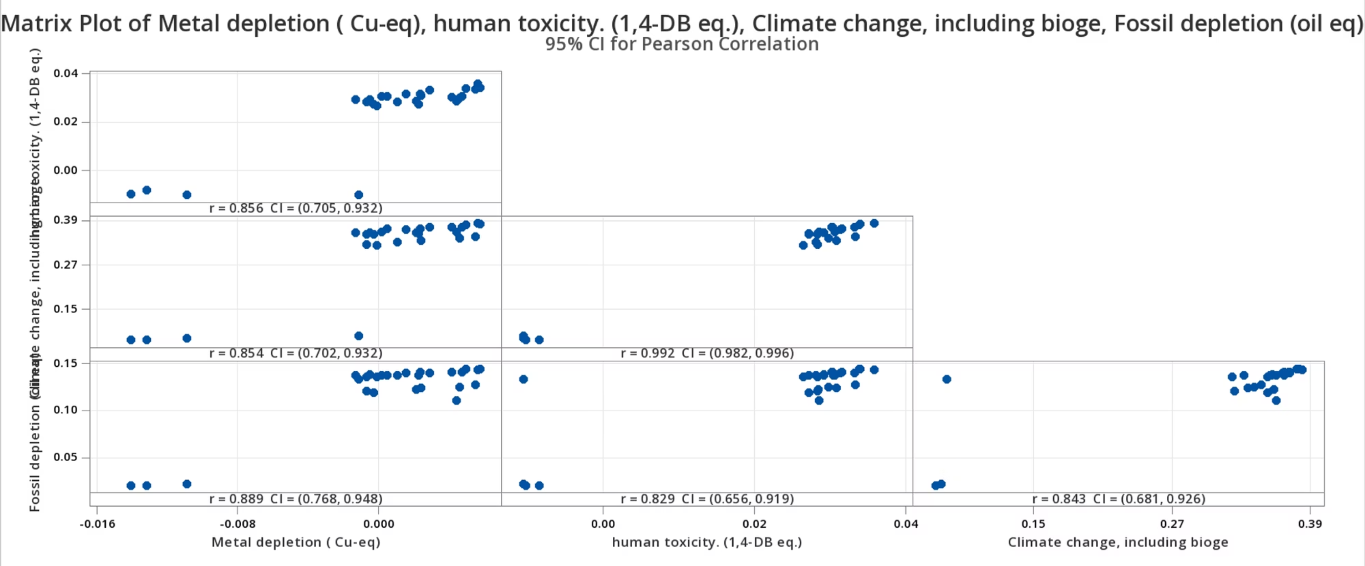

Slide 9
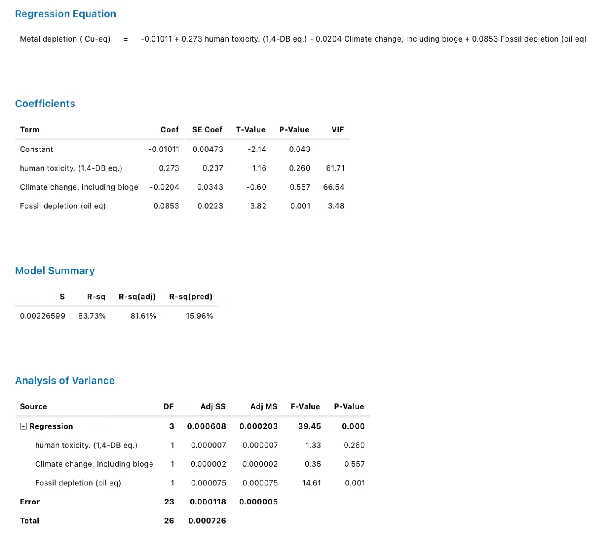
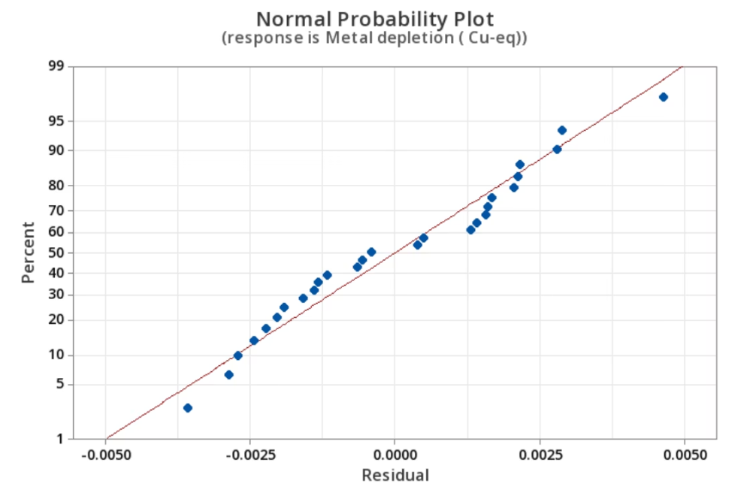
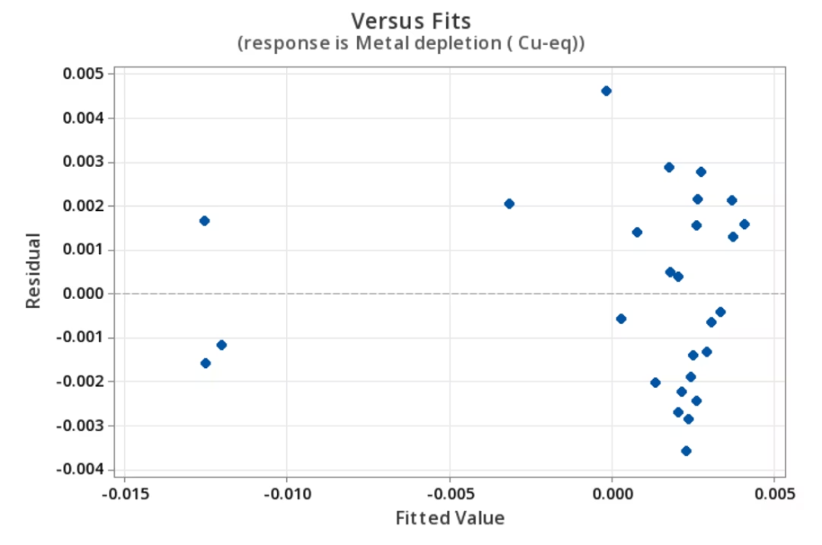
Regression Analysis

Slide 10

Scenario Structure: Clustering & PCA Biplot
High-Impact Cluster
Medium-Impact Cluster
Comprised predominantly of virgin material scenarios, underscoring the significant environmental costs associated with new resource extraction and production.
Characterized by scenarios incorporating partially recycled content, demonstrating a measurable reduction in overall impact compared to virgin production.
Low-Impact Cluster
Features scenarios with high recycling rates, hydrometallurgical processes, and repurposing strategies, representing the most environmentally favorable pathways.
The PCA biplot visually reinforces these clusters: virgin scenarios reside on the high-PC1 side, aligning with higher environmental burden. Conversely, advanced recycling and repurposing scenarios—especially the silicon-anode variants 5, 6, and 7—are positioned on the low-PC1 side, indicating their superior environmental performance.

Slide 11
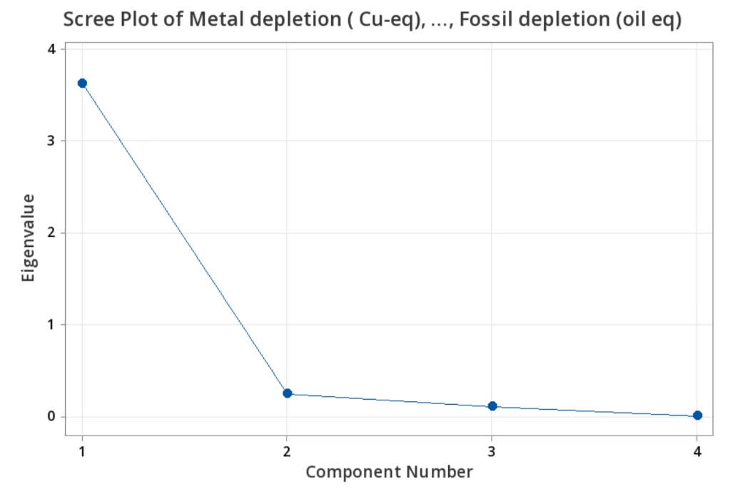
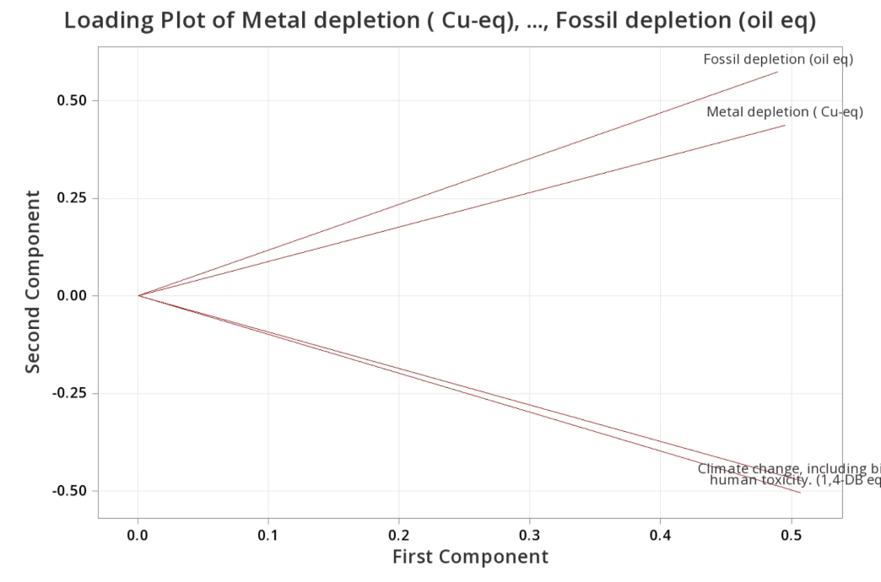
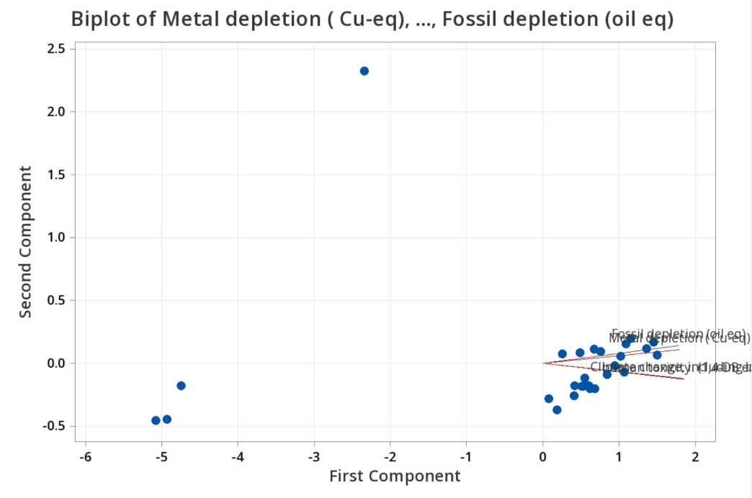
Graphs
Scree Plot
Loading Plot
Biplot

Slide 12
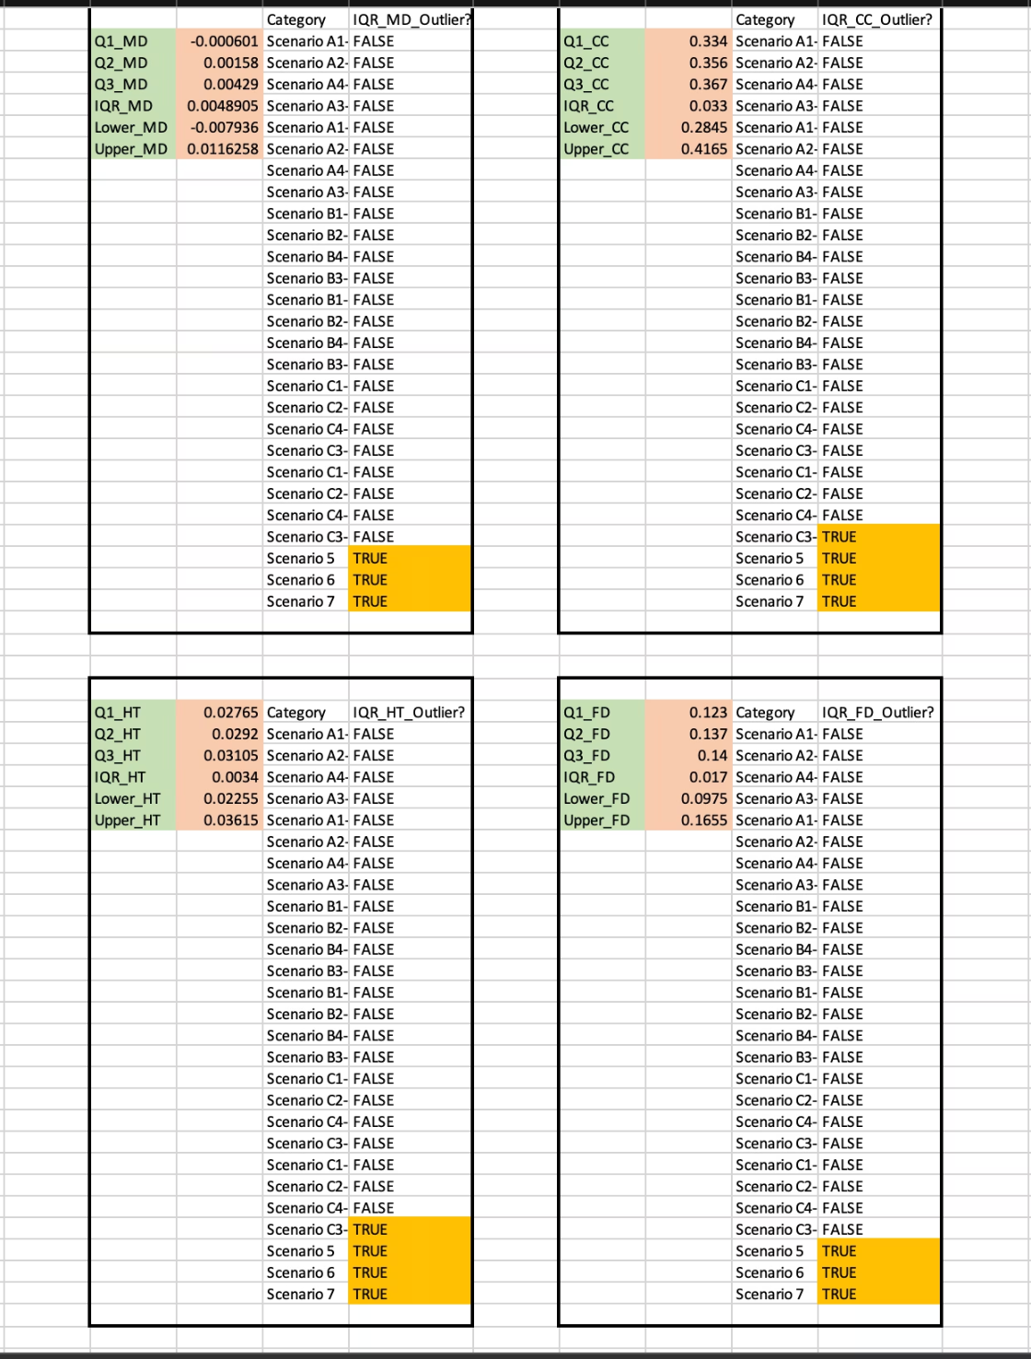

Outlier Detection with Excel: Z-Scores and IQR
Z-Score Analysis:
Using Z-scores, no scenario exhibited a |Z| > 3, indicating the absence of extreme high-impact outliers within the dataset. However, silicon-anode Scenarios 5, 6, and 7 consistently showed Z-scores of approximately −2.5 for Climate Change (CC) and Fossil Depletion (FD), and similarly low values for MD and HT. These findings flag them as "possible" low-side outliers for several key indicators.
Interquartile Range (IQR) Method:
The IQR method further refined our understanding of these exceptional scenarios:
For Metal Depletion (MD) and Fossil Depletion (FD), Scenarios 5, 6, and 7 were the only scenarios identified as low-side IQR outliers.
For Human Toxicity (HT) and Climate Change (CC), Scenarios 5, 6, and 7, alongside Scenario C3, were identified as low-side IQR outliers.
These are critically "good" outliers—they represent statistically exceptional, low-impact configurations that consistently outperform other scenarios.

Slide 13

Detailed Conclusion & Future Directions
Our multivariate life cycle analysis provides robust evidence for critical shifts in EV battery end-of-life strategies:
The four midpoint indicators (MD, HT, CC, FD) are highly correlated, behaving as a single underlying environmental burden dimension. The PC1 environmental burden index effectively captures approximately 90% of this variance, offering a simplified metric for comprehensive impact assessment.
Virgin production scenarios consistently represent the worst environmental performers across all analytical methods.
Strategies involving increased recycled content, the application of hydrometallurgical recycling routes, and repurposing batteries significantly reduce MD, HT, CC, and FD simultaneously, moving scenarios into lower-impact clusters and towards lower PC1 scores.
Silicon-anode Scenarios 5, 6, 7 (and Scenario C3 for HT and CC) are repeatedly flagged by PCA, clustering, Z-scores, and IQR analysis as the best-in-class, low-impact options.
The PC1 can be effectively utilized as a simple, single index for ranking and comparing diverse end-of-life strategies, facilitating clear communication to stakeholders.
Future Work:
Extend the multivariate analysis to include additional midpoint and endpoint indicators for a holistic view.
Integrate economic cost and policy constraints to develop optimization models, e.g., minimizing costs while adhering to a defined PC1 environmental burden threshold.
Apply these advanced multivariate statistical methods to other complex LCA case studies across various industries.

